Slide 1
Practical Aspects of Quantum Coin Flipping
Anna Pappa
Presentation at ACAC 2012

Slide 2
What is Quantum Coin Flipping?
quantum
channel
classical
channel
Strong CF : the players want to end up with a random bit
Weak CF : the players have a preference on the outcome

Slide 3
Definitions
A strong coin flipping protocol with bias ε (SCF(ε)) has the following
properties :
If Alice and Bob are honest then Pr [c = 0] = Pr [c = 1] = ½
If Alice cheats and Bob is honest then P*Α = max{Pr [c = 0],Pr [c = 1]} ≤ 1/2 + ε.
If Bob cheats and Alice is honest then P*Β = max{Pr [c = 0],Pr [c = 1]} ≤ 1/2 + ε.
The cheating probability of the protocol is defined as max{P*Α,P*B}.
We say that the coin flipping is perfect if ε=0.

Slide 4
Background
Impossibility of classical CF =1
Impossibility of perfect quantum CF(LC98) >1/2
Several non-perfect protocols:
Aharonov et al (‘00) = (2+√2) /4
Spekkens, Rudolph(‘02), Ambainis(’02) =3/4
Kitaev’s theoretical proof (‘03) ≥1/√2
Chailloux, Kerenidis protocol (‘09) ≈1/√2

Slide 5
Practical Considerations
Channel noise
System transmission efficiency, losses
Multi-photon pulses
Detectors’ dark counts
Detectors’ finite quantum efficiency

Slide 6
Some practical results
Berlin et al (‘09)
Chailloux (‘10)
Loss-tolerant with cheating probability 0.9
Loss-tolerant with cheating probability 0.86

Slide 7
Berlin et al protocol
Properties
Allows for infinite amount of losses
Doesn’t allow for conclusive measurement (the two distinct density matrices cannot be distinguished conclusively)
Disadvantages
Not secure against multi-photon pulses (ex: for 2-photon pulses, there is a conclusive measurement with probability 64%)
Doesn’t take into account noise and dark counts.

Slide 8
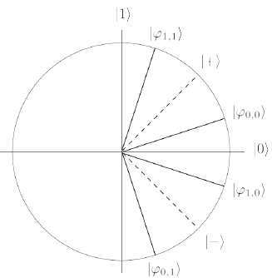
Our Protocol
The Protocol uses K states (i=1,...,K), where αi is the basis and xi is the bit:
,
The measurement basis is defined for :

Slide 9
Our Protocol
For i=1,...,K
measure in

Slide 10
Our Protocol
For i=1,...,K
measure in
If Bob’s detectors don’t click for any pulse, he aborts. Else let j be the first pulse he detects.
If , Bob checks the correctness of the outcome and aborts if not correct.
If he doesn’t abort, then the outcome is .

Slide 11
Properties of the protocol
We take into account all experimental parameters.
We use an attenuated laser pulse (the number of photons μ follows the Poisson distribution), instead of a perfect single photon source or an entangled source.
We bound the number of sent pulses.
We allow some honest abort probability due to the imperfections of the system (noise).

Slide 12
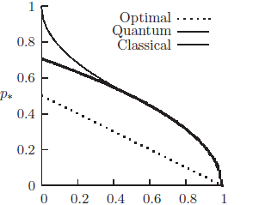
Coin flipping with honest abort
Hanggi and Wullschleger (2010) defined CF that is characterized by 6 parameters:
The honest players will abort with probability .

Slide 13
Our Results
Parameter |  | Value
Detector constant loss [dB] | k | 1
Absorption coefficient [dB/km] | β | 0.2
Detection efficiency | η | 0.2
Dark counts (per slot)
Signal error rate | e | 0.01

Slide 14
Different Models
Unbounded computational power
(all-powerful quantum adversary)
Bounded computational power
(inability to inverse 1-way functions)
Bounded storage
(noisy memory)

Slide 15
Bounded Computational Power
Suppose there exist:
a quantum one-way function f
A hash function h
There exists a protocol with cheating probability 50% when the adversary is computationally bounded.

Slide 16
Bounded Computational Power
Pick string s
Pick string s’
For i=1,...,K
measure in
If Bob’s detectors don’t click for any pulse, he aborts, else let j be the first pulse
Bob checks the correctness of the outcome for same bases.
If he doesn’t abort, then the outcome is .

Slide 17
Noisy Storage
Introduced by Wehner, Schaffner and Terhal in 2008 (PRL 100 (22): 220502).
Adversary has a noisy storage for his qubits.
Protocol needs waiting time Δt in order to use the noisy memory property.
There exists a protocol with cheating probability 50% when the adversary has a noisy quantum memory.

Slide 18
Implementations
G. Molina-Terriza, A. Vaziri, R. Ursin and A. Zeilinger (2005)
A.T. Nguyen, J. Frison, K. Phan Huy and S. Massar (2008)
G. Berlin, G. Brassard, F. Bussières, N. Godbout, J.A.Slater and W. Tittel (2009)

Slide 19
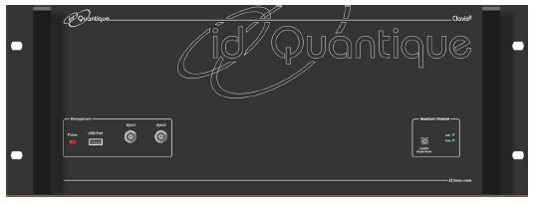
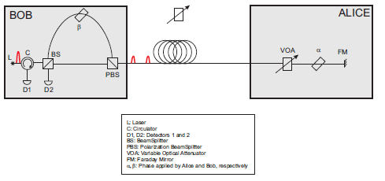
The Clavis2 System

Slide 20
